Slide 1
CONSTRUCTION PROJECT MANAGEMENT
“The term CONSTRUCTION is no longer limited to the physical construction process but covers entire activities from conception to realization of a construction project”
Mr. A. A. Magdum B.Tech Civil 2022-23

Slide 2
Ch. 1 Introduction to construction project management
Construction project: unique features, types, phases, role in economic development, role of stakeholders, regulatory requirements.
Construction project management and its relevance
Construction project organization: structure, traits of project manager, project coordinator

Slide 3
Know your facilitator..
A. A. Magdum
Assistant Professor,
Civil Engineering Department
Email : anmol.magdum@walchandsangli.ac.in
Previous Experience:

Slide 4
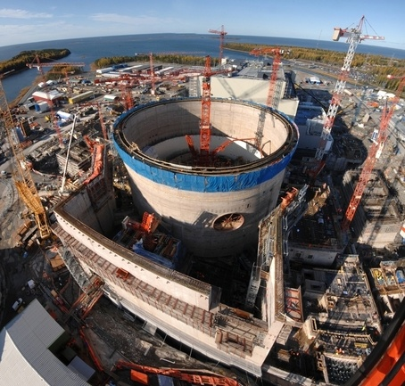

Slide 5
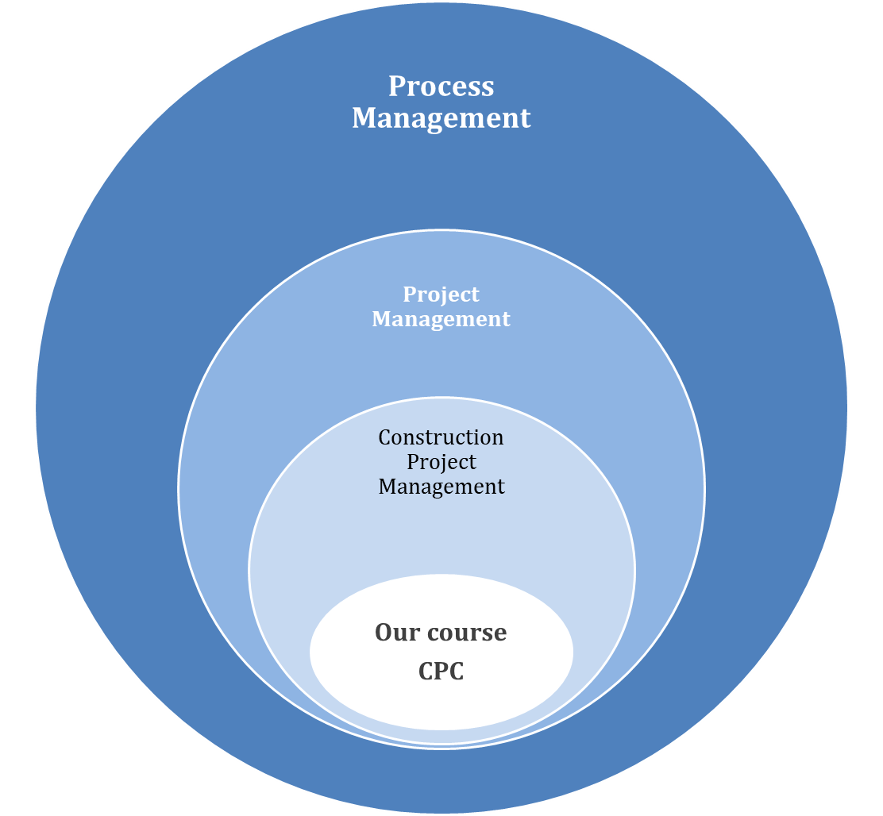
Knowledge area introduction

Slide 6
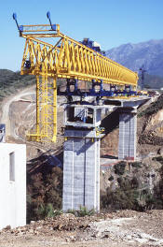
Knowledge areas in construction project management
Project Integration management
Project Scope Management
Project Time Management
Project Resources Management
Project Cost Management
Project Quality Management
Project Procurement / Contract Management
Project Human Resource Management
Project Communications Management
Project Risk Management
Construction Technology Management
Construction Site Management
Project Information Management

Slide 7
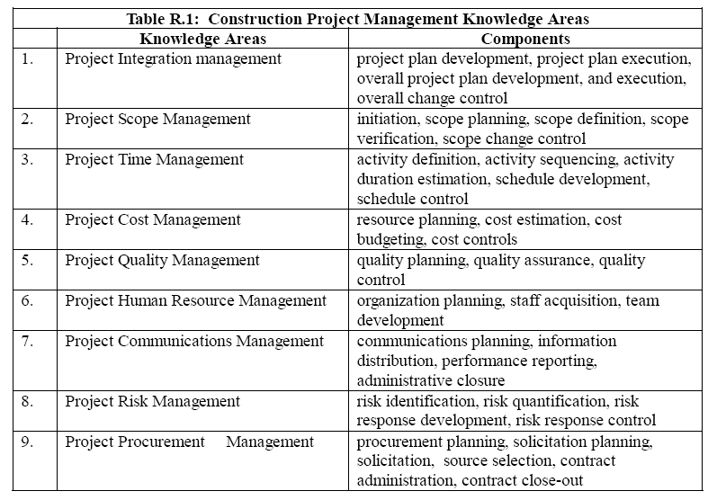

Slide 8
Construction Projects Management Framework, Indian Construction Scenario
Project Work Breakdown
CPM / PERT Network Analysis
Precedence Network Analysis
Project Work Scheduling
Planning Construction Manpower , Materials , Equipment, Finance
Project Construction Equipment
Planning Construction Costs (Construction Economics )
Planning Construction Budgets
Project Scope Control
Project Cost Control
Project Time Control
Construction Safety Management
Project Quality Management
Project Risk Management
Construction Contracts Administration
Project Management Information System

Slide 9

The job of the construction manager
Inputs
Process
Output
risks
is to take a set of written plans and specifications and a raw piece of land and
then coordinate all of the materials, manpower, and equipment necessary to
guarantee the set price, schedule, and quality of the project—without any accidents or errors,
regardless of weather conditions, interest rate fluctuations, acts of God, or any other unforeseen conditions.

Slide 10
Syllabus…
1 | Introduction to construction project management: Construction project: unique features, types, phases, role in economic development, role of stakeholders, regulatory requirements. Construction project management and its relevance Construction project organization: structure, traits of project manager, project coordinator | 7
2 | Construction project planning and scheduling Stages of project planning: pre-tender ,pre-construction and detailed construction planning Process of development of plans and schedules: work break-down structure, activity lists, assessment of work content, estimating durations, sequence of activities. Planning techniques: Bar charts, Networks: basic terminology, types, advantages Formulation and analysis of CPM networks(AOA , AON and precedence networks) Formulation and analysis of PERT networks. Introduction to line of balance technique. Resource Scheduling- resource constraints and conflicts, resource aggregation, allocation, smoothening and levelling, calendaring networks. Other schedules derived from project schedules | 13
3 | Construction materials management and cost management- Construction materials management: Materials flow system, role of materials management in construction management and its linkage with other functional areas, vendor networking, buyer-seller relationships, EOQ model and its variations, material codification and classification, concept of logistics and supply chain management, role of ERP in materials management – material resource information systems, Construction costs management- cost classification, cost codes, resource planning schedules, cost planning, cost budgeting, value management in construction, time cost trade-off in construction projects, compression and decompression | 8

Slide 11
4 | Project Monitoring & control- Progress control : measuring progress, periodic progress reports Updating of plans: purpose, frequency and methods of updating. Cost control, Earned value analysis Introduction to Management Information System Common causes of time and cost overruns and corrective measures. | 6
5 | Construction Quality and Safety management Quality assurance & control: key aspects , Quality Assurance Policy, use of manuals and checklists for quality control(Typical checklist for concreting, formwork and reinforcement activity), role of inspection, Introduction to TQM, quality audit, cost of quality, ISO standards Safety and health on project sites: accidents causes and effects, costs of accidents, occupational health problems in construction, Safety and health management system Health and safety act regulations | 7

Slide 12

Know your Industry
What is Civil Engineering?
Planning,
Designing,
Constructing,
Maintaining, Operating,
Demolishing
Civil works( immovable facilities)
What is Construction
Project Management?

Slide 13

CONSTRUCTION SCOPE
Past History
  Caveman started building his dwellings.
  Ancient times,(wonders )
  Pyramids of Egypt,
  Great Wall of China,
  The medieval times
  Taj Mahal in India
  Leaning Tower of Pisa in Italy.
  A more recent example :
  Eiffel Tower
  high-rise skyscrapers.

Slide 14
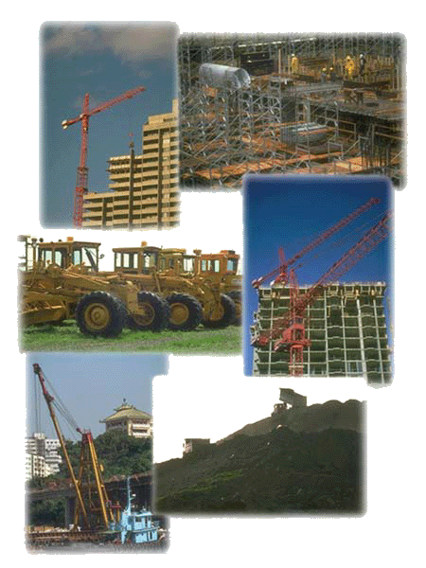
In the present day world,
Can you name few modern days Construction projects?

Slide 15
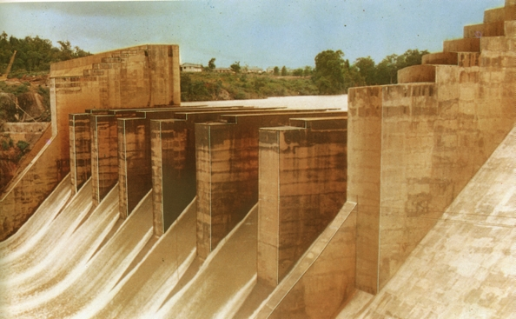
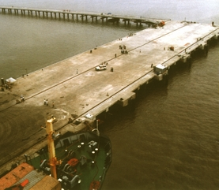
High-rise buildings,
Dams and irrigation networks,
Energy conversion and industrial plants,
Environmental protection works,
Infrastructure facilities like roads, bridges, railways, airports and seaports,
Satellite launching stations,
On-shore and off-shore oil terminals.

Slide 16
What is Project ?
“temporary endeavor undertaken to create a new product or service to achieve specified objectives within the assigned resources. “
  Constructing a building or facility. ·
  Developing a new product or service. · Tata Nono
  Designing a new transportation system.
  Running a campaign for political office.
specified mission or a purpose that has to be achieved within time, budget and quality specifications.
Its organization is temporary.
Each project mission is unique as no two projects are ever alike.
( client, the contractors, quality specifications, resources employed, responsibilities delegated and the project environments)

Slide 17

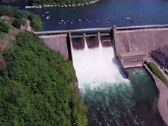
Construction Project Categories.
Building Construction
  Residential and commercial complexes,
  Educational and recreational facilities,
  hospitals and hotels, Etc.
(largest segment)
Infrastructure Construction
heavy construction, equipment-oriented works I
  Dams and canals,
  Highways and airports, railways
  Oil/gas pipelines and transmission lines,
  Water supply and sewage disposal networks,

Slide 18
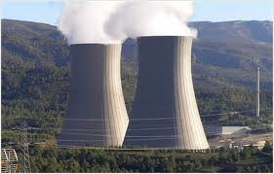
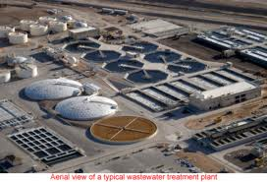
Industrial Projects
  Steel mills,
  petroleum refineries,
  Consumer goods factories,
  Nuclear and thermal power plants,
Special-Purpose Projects.
  Environmental works,
  Emergencies, remedial works,
  Installation and commissioning of equipment,
  key operations.

Slide 19
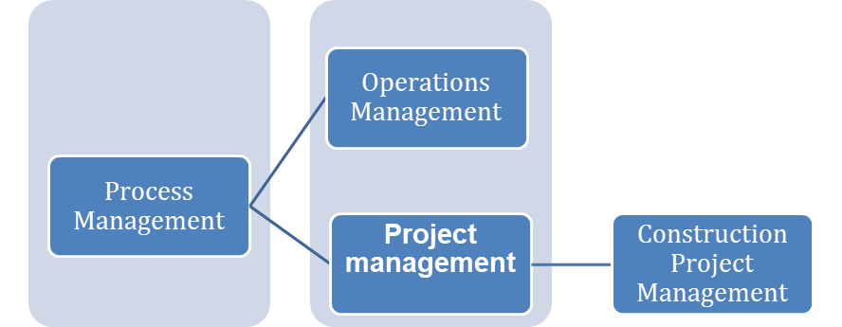
Project management
“planning, monitoring and controlling of all aspects of a project
to achieve the project objectives
on time and to the specified cost, quality and performance.”

Slide 20
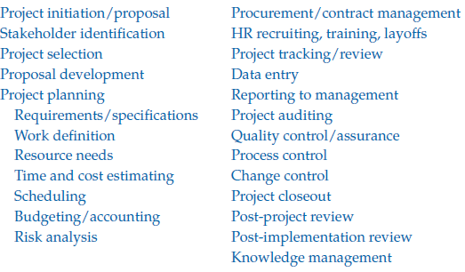
Project management tasks and deliverables

Slide 21
The Planning, Scheduling and Controlling methodology employed for achieving project objectives is called Project Management Techniques
Planning,
  “specifies a pre-determined and a committed future course of action,”
  “process of developing a project plan.”
Scheduling
  “putting the plan on a calendar time scale”
Monitoring
  During the execution stage, brings out the progress made against the planned base line.
Controlling:
  “formulation and implementation of corrective actions necessary for achieving project objectives. “

Slide 22
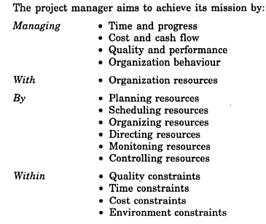

Slide 23
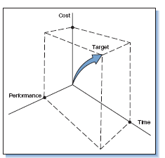
What is a Successful project? if the project is completed,
Within the allocated time period.
Within the budgeted cost.
At the proper performance or specification level.
With acceptance by the customer/user. & Statutory Authorities
With minimum or mutually agreed upon scope changes.
Without disturbing the main flow of the organization.

Slide 24
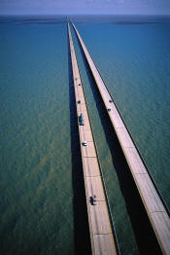
Why do construction projects usually fail to achieve their mission?
Inadequate project formulation
    poor feasibility study,
    inadequate field investigations,
    ill-defined project scope,
    inaccurate cost estimates,
    insufficient project appraisal and investment decisions
    improper selection of the project manager.
Improper management.
    Organizational Failure
    Resource Failure
    Directional Failure
    Controlling Failure.
    Co-ordination Failure

Slide 26
Unique Features of a Construction Project…..zha
One-time activity—
Complexity—it is multidisciplinary because it involves a set of interrelated tasks to be done by specialists
High cost and time for execution
High risk of failure
Difficulties in defining quality standards
Uniqueness of people relationship
Feedback mechanism
Lack of experience of client or owner
Untrained workforce

Slide 27
Construction projects Management Vs
Process industries management?
Projects are unique and transient
organization is temporary.
Projects are time bound, new tasks.
risk-prone, complex situations and resource constraints.
Project time and cost are correlated. Time delays can increase costs exponentially instead of linearly as in the case of most of ongoing enterprises.
Project tasks leave no time for the training or learning process.
employ experienced staff with proven skills to respond fast to changing situations and to speed up decisions.
Complex , dynamic project environments.
Construction projects are executed with the support of contracting agencies, whereas ongoing industrial processes are managed by the departmental staff and workers.

Slide 28
Construction Manufacturing industry industry
Projects are unique and transient
(risk-prone, complex situations)
Dynamic Environment
No Industry status
Temporary Organization
(Casual labor )
Location disadvantage
Multiple parties
Low fixed cost( hiring Equip.. labour, staff)
Low working capital requirement
Intermediate payments(R.A. bills, advances)
Time delays can increase costs exponentially
No time for the training or learning process.
Repetitive Operations
More stable Environment
Industry status
More permanent staff
Location stability, Convenience
Lesser no. of parties
Huge initial fixed cost( plant)
Higher working capital
Payment on delivery to customer

Slide 29
Construction Project Life cycle
        Construction Phase
Planning phase.
& Procurement
Project Initiation phase
Executing phase
Close-up phase
Control Processes

Slide 30
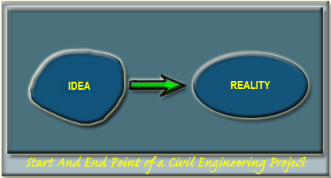
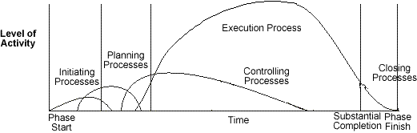

Slide 31
Project Initiation Phase
Need analysis
development of the infrastructure, setting-up an industry, expanding or diversifying the existing business activity, meeting the needs of society, investment in real estate
Feasibility study
  o Market analysis, o Technical analysis o Financial analysis
  o Economic analysis o Ecological analysis
Investment appraisal – Go ahead decision
“critical examination of the techno-economic analysis of the feasibility findings”
USE OF Capital budgeting Techniques( NPV, Benefit/cost ration etc.)
Project scope formulation & Implementation Strategy

Slide 32
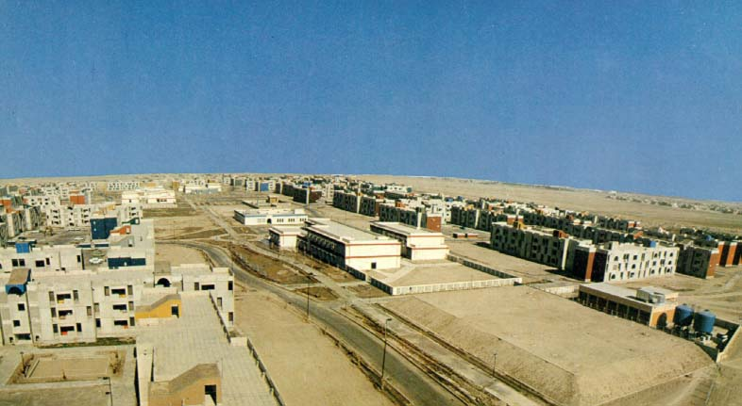
Project scope
“work that must be done in order to deliver a product or service with the specified features, functions and constraints.”
2000 HOUSING UNITS PROJECT

Slide 33
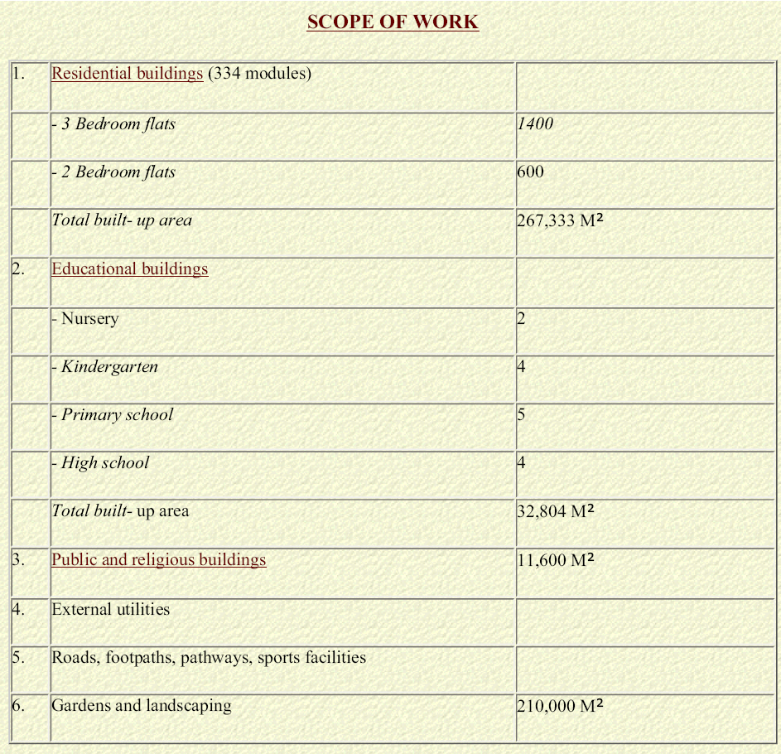
2000 HOUSING UNITS PROJECT

Slide 34
Project Planning Phase
Project Activities Identification ( WBS)
to identify and list the specific activities that must be performed to complete the project scope of work.
Activity Duration Estimation
to determine the time period and the connected resources
Project Activities Sequencing / Modeling ( CPM/PERT Networks) to depict logic of activities using standard symbols and conventions.
Project Time Analysis
to identify the critical path and compute the project completion time.
Project Schedule Development
to create a work schedule keeping in mind the imposed constraints on the project.

Slide 35
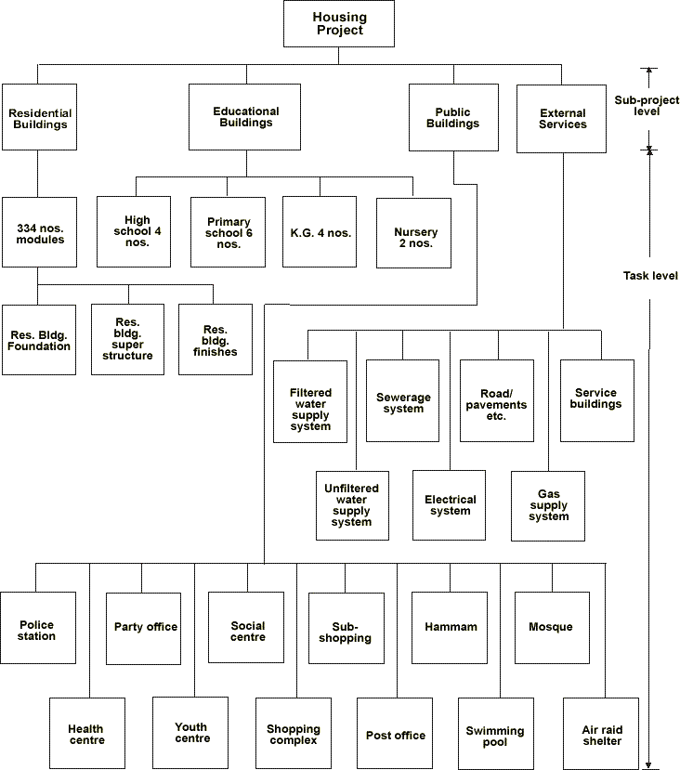

Slide 36
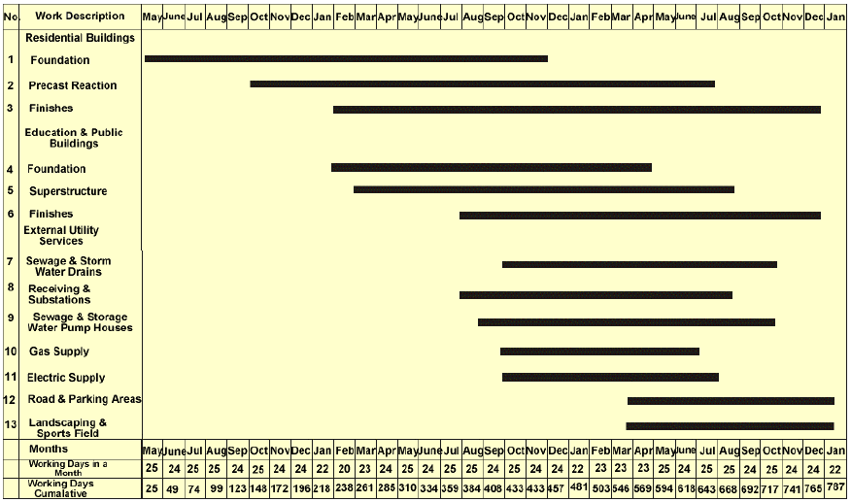
Bar chart schedule

Slide 37
Designs and drawings planning
Time planning
Resource planning
Cost planning and budgeting
Communications planning
Quality assurance planning
Organizational planning
Construction contracts procurement planning
Risk management planning

Slide 38
Project Executing Phase:
Construction
Project site organization
Resources mobilization
Scope quality assurance organization
Information distributions
Contract administration
Safety management

Slide 39
Project Executing Phase:
Performance controlling
Overall scope change control
Resources control
Schedule control
Cost control
Quality control
Risk response control
Performance reporting

Slide 40
Project Closing Phase
Administrative close
Contract close-out
Lessons learnt

Slide 41
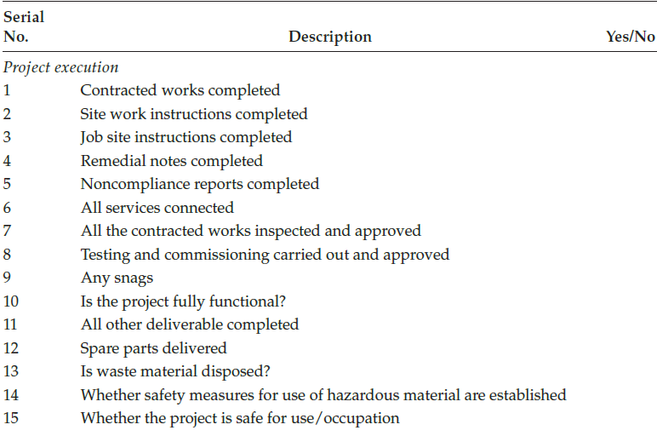
Project Closeout Checklist

Slide 42
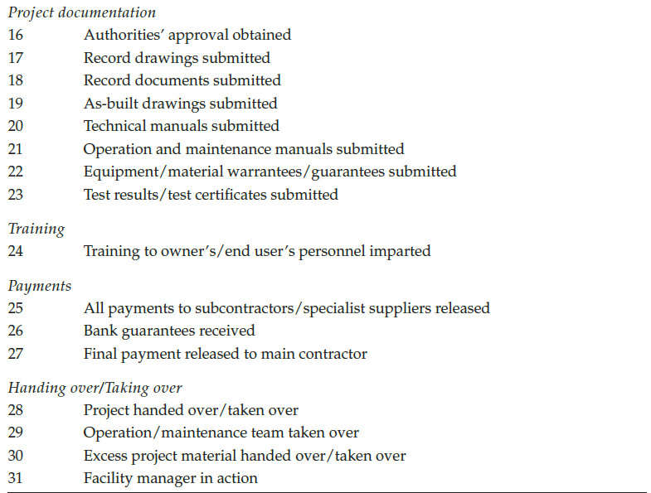

Slide 43
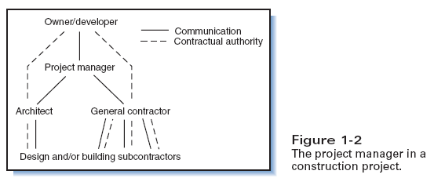
Project stakeholders or participants
“Individuals and organizations who are actively involved in project execution or successful project completion”
Business Promoters/Owners.
Architect-Engineering Associates.
Construction Management Consultants.
Input Suppliers.
Contractors.
Project Manager.

Slide 44
Stakeholder | Examples | Function
1. Business Promoters/Owners | Government Bodies Private Agency Entrepreneur Builder Investor | Potential owner/ user Sponsor/ Finance Every stage
2. Architect – Engineering Firms | Architects Engineers : structural, General ( Electrical/ Mech/ Plumbing) | Design of Landscape & Building Aesthetic features Develops structural systems (Electrical/ Mech/ Plumbing)

Slide 45
Stakeholder | Examples | Function
3. Construction Management consultant

Slide 46
Construction participants…..
(a) Construction business promoters like government bodies, public and private enterprises for real estate and industrial development, and other similar agencies.
(b) Construction management consultant firms.
(c) Architect-engineering associates.
(d) Construction manpower recruitment and training agencies.
(e) construction materials developing, manufacturing, stocking, transportation and trading firms.
(f) Construction plant and machinery manufacturing, distributing, and repair and maintenance organizations.
(g) Banking and finance institutions.
(h) Risk insurance and legal services companies.
(i) Construction quality assurance, and research and development
(j) Contractors and contracting firms.

Slide 47
Construction management consultant
General duties
(a) Project feasibility, including cost estimates.
(b) Site survey and soil investigations.
(c) Scrutiny and coordination of designs and drawing work.
(d) Estimating, initial planning, and budgeting costs.
(e) Processing prequalification of construction agencies, tendering, and awarding contracts to the successful bidders.
(f) Designing project organizations nor executing works and developing standard operating procedures and systems.
(g) Developing detailed construction plans, project schedules and performance measuring standards.
(h) Supervising works, including administration of contracts and controlling of project time, cost and quality objectives.

Slide 48
Architect- Engineering associates
Architect
  designs the buildings, landscapes and other artistic features.
Engineers
  develop structural, electrical, mechanical and other specialist systems and designs.
Some of these firms also provide construction management services.

Slide 49
Input suppliers
“Men, materials, machinery and money”
The workforce
  includes architects, engineers, manager, technical and non-technical staff, highly skilled operators, and skilled and unskilled manpower.
Wide variety of materials,
  which form a substantial part of the entire construction cost.
Construction plant and machinery
  has revolutionized construction practices by adding the speed factor and reducing the need for difficult-to-manage manpower.
Money
  construction being a capital intensive business, generally also operates under money constraints.

Slide 50
Contractors
Sr No | Contractor( constructor) | function
01 | General Contractors | Coordinates various tasks for a project
02 | Specialty contractors | perform the work in their specialties
 | Ex. mechanical, electrical, foundation, excavation, demolition
03 | Material and Equipment Suppliers | steel fabrication and erection, sheet metal, ready mixed concrete delivery, reinforcing steel bar detailers, roofing, glazing etc.

Slide 51
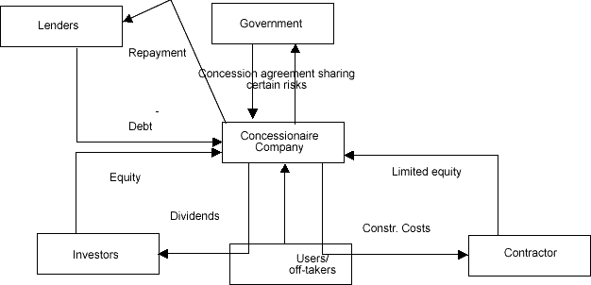
Construction Project stakeholders example: BOT project

Slide 52


How Is Construction Project Management Organized?
Project organization is temporary.
special attribute: ability to innovate to overcome problems
It is staffed with experienced persons to respond speedily to changing situations and to speed up decision making.

Slide 53
Guidelines for designing the project organization
to generally conform with the project WBS
Each group is assigned respon5ibilities and allocated resources to meet the assigned tasks.
The size and structure or the organization is changed due to alternation in requirements. (core project team continues till the end. )
Project groups are suitably structured with emphasis on team work and informal relationship.

Slide 54
Organization structure is kept flat to avoid bureaucratic tendencies and reduce channels of communication with the project manager.
where possible, key staff is derived from their respective parent departments in corporate office
The heads of line and staff departments are generally grouped into project management team and planning chief is assigned responsibility or the coordination function.

Slide 55
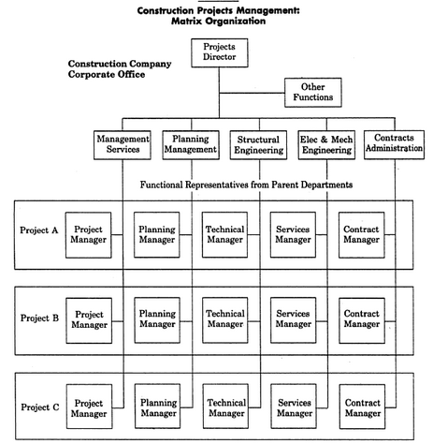
Matrix Organization in construction Industry

Slide 56
Advantages
(a) It has a single PM accountable for the whole project.
(b) All managers owe their allegiance to the PM , and not to their parent departmental heads.
(c) Personal commitment to objectives is the key
(d) The top management is freed from making routine decisions,
(e) It provides enough flexibility to meet uncertain and changing situations by establishing a project planning and control system at site to monitor the input flow of resources and the performance output.

Slide 57
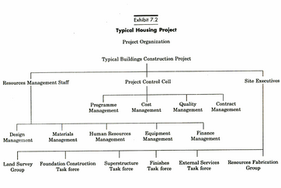

Slide 58
Role of PM
is the king pin
is entrusted with the task of integrating the interdisciplinary and inter-organizational efforts under changing environments for successful accomplishment or the specified objectives.
Operates independently of the normal organizational chain of command,
He assumes total responsibility and accountability

Slide 59
PM’s responsibilities include
team building,
financial control,
contract management,
technical management,
resources management,
interface management and quality management.

Slide 60
Ten related roles of the project manager
(a) Figurehead role
    legal and social head of the project, is the single focal point for making decisions, ceremonial functions and symbolic duties.
(b) Leadership role
(c) Liaisoning role
    maintains contacts outside the organization,
(d) Monitoring role

Slide 61
(e.) Disseminator’s role
    transmits the relevant information received from external sources and internal systems to the concerned people in the work place.
(f) spokesperson's role
    acts as the sole representative
(g) Entrepreneur’s role
    seeks and identifies opportunities to promote improvements and needed changes.
(h) Disturbance handling role
(i) Resources allocator role
(j) Negotiator’s role

